Slide 1

Impact of Vaccinations on COVID-19 Deaths
DATS 6101, Group 4 Final
Kyle Hall, Aishwarya Maddula, Micah Sanders, Xiaopu Zhou
March 20, 2024

Slide 2
Policy Background
COVID-19 likely led to 1.2m deaths in the US
Vaccines reduced deaths globally
Uneven impact on regions
The southern US was particularly hard hit
The region also lagged the nation in vaccination rate
Southern states resisted policy solutions
Lower rate of mask mandates
Less strict immunization guidance
Sources
https://covid.cdc.gov/covid-data-tracker/#datatracker-home
https://www.thelancet.com/journals/laninf/article/PIIS1473-3099(22)00320-6/fulltext
https://www.ncbi.nlm.nih.gov/pmc/articles/PMC9049562
https://www.jstor.org/stable/26976653
https://www.hrw.org/news/2020/05/05/us-southern-states-ease-covid-19-restrictions-risking-black-lives

Slide 3


Smart Questions
Did vaccinations impact survival rates from COVID-19 between 2020 and 2023?
Were there differences in COVID-19 survival rates between regions of the US?
Did policy choices made by states impact survival rates?

Slide 4



Dataset Overview
Before cleaning
Datasets – 3, Rows – 659542, Columns – 126
After cleaning
Datasets – 1, Rows – 8754, Columns - 12
Final Dataset
Date, Regions,Cases, Death count, Vaccination, Policy
Deaths
(usafacts.org)
Cases (usafacts.org)
Vaccination
(data.cdc.gov)
Policy
(healthdata.gov)
Regions
(census)
Date
State
Death count
Date
State
Cases
State_ID
Policy_Type
Start
Stop
Date
State
Vacc
State
Regions

Slide 5
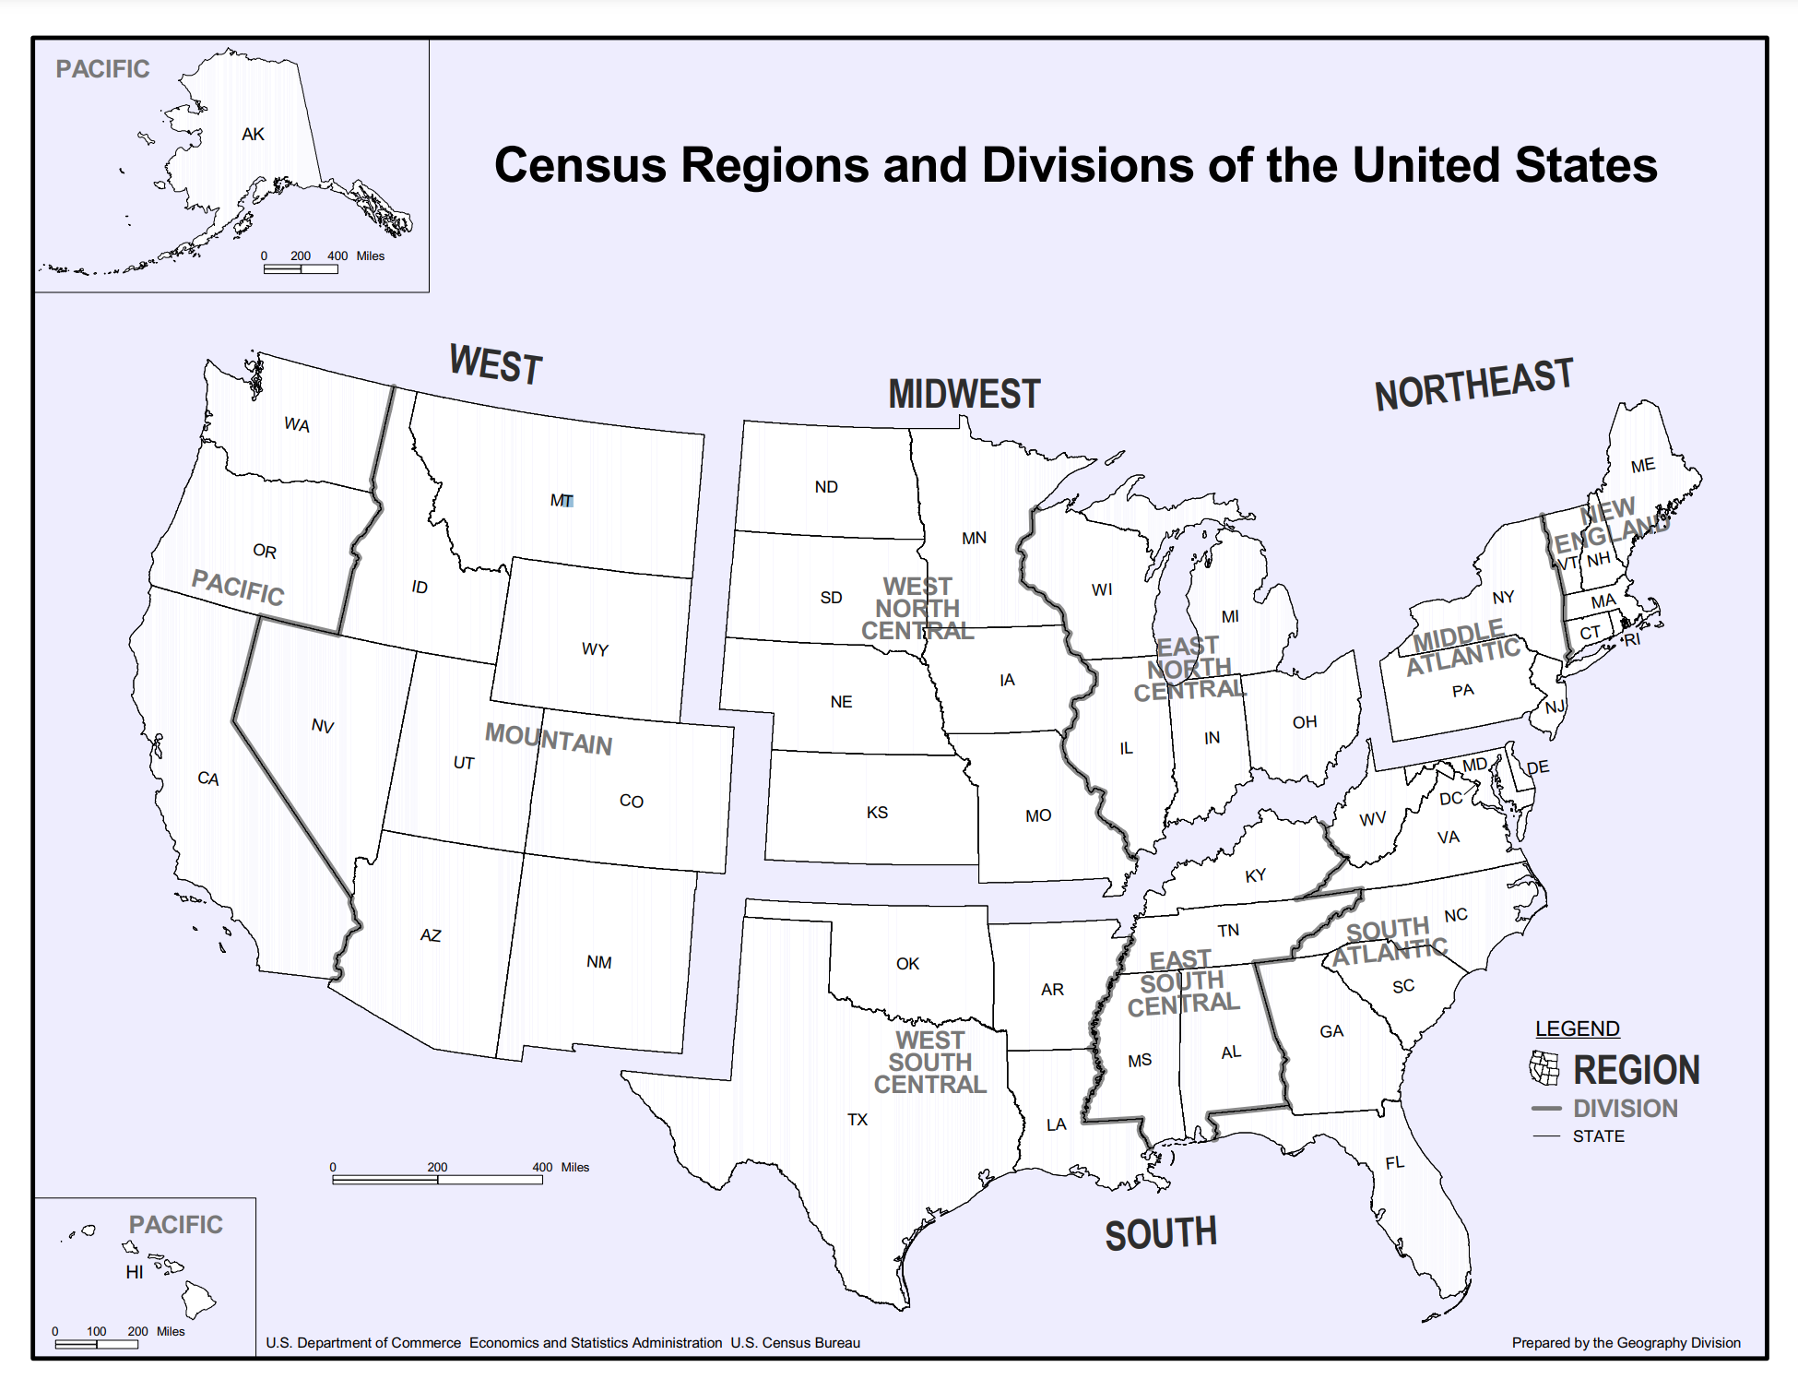
Regions

Slide 6


Data Cleaning Overview
Cases , Deaths: Drop Unused Columns, Aggregate county data to states, transpose data, Calculate weekly change based on mondays
Vaccination: Consider vaccination percentage (age wise segregation), calculate weekly vaccination rate
Policy: Consider state level policies, pick important policies, calculate start and end date of policy, generate list of dates that contain these policies, merge them into dataframe, create dummies for policy
Regions: Mapped state to regions
MISSING RECORDS
CUMULATIVE TO MARGINAL

Slide 7
Data Cleaning
MISSING RECORDS
CUMULATIVE TO MARGINAL

Slide 8

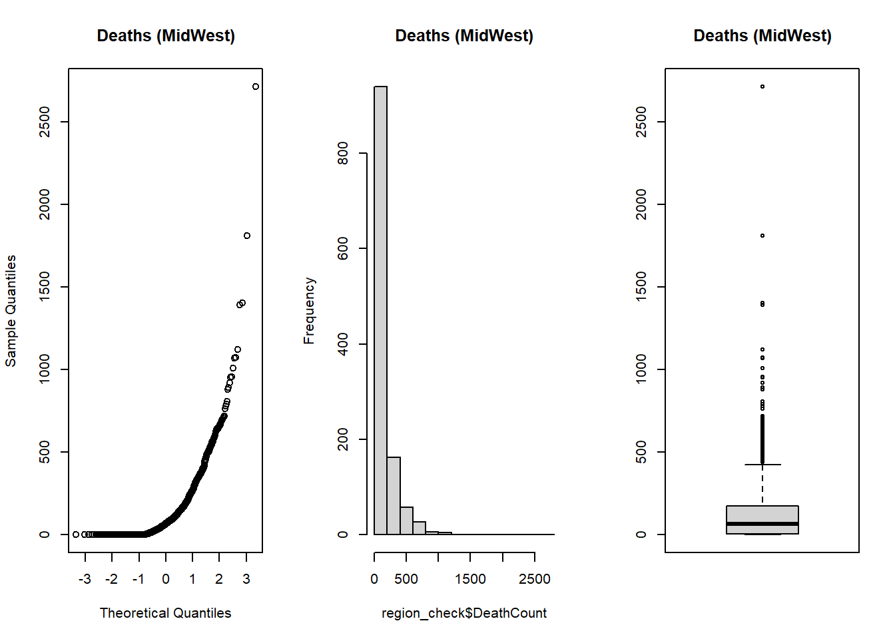
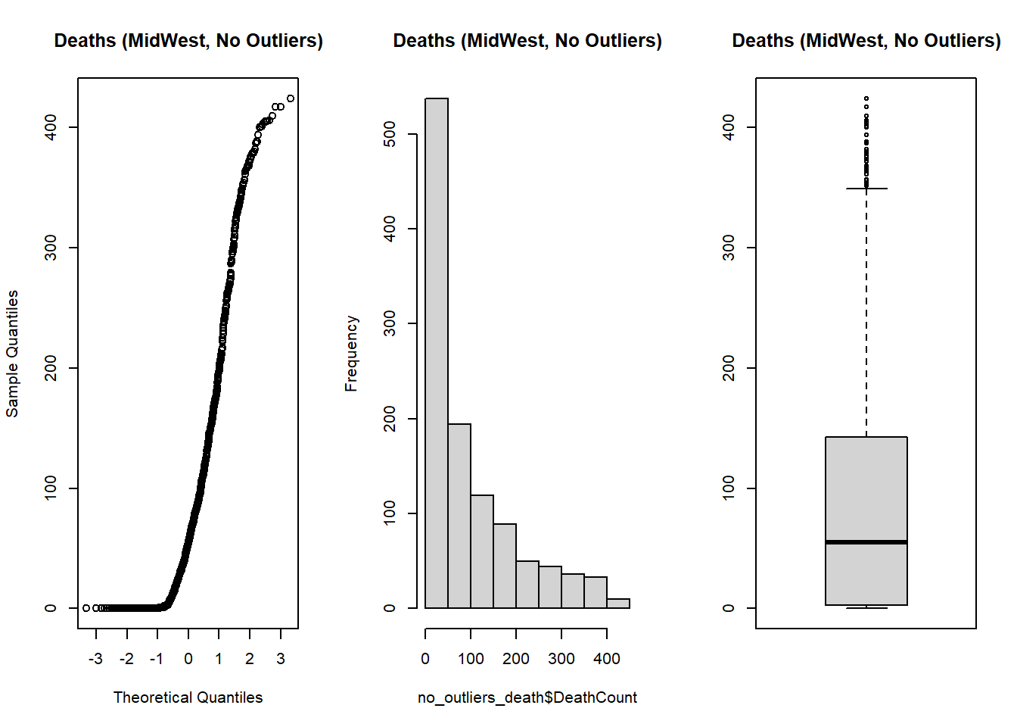
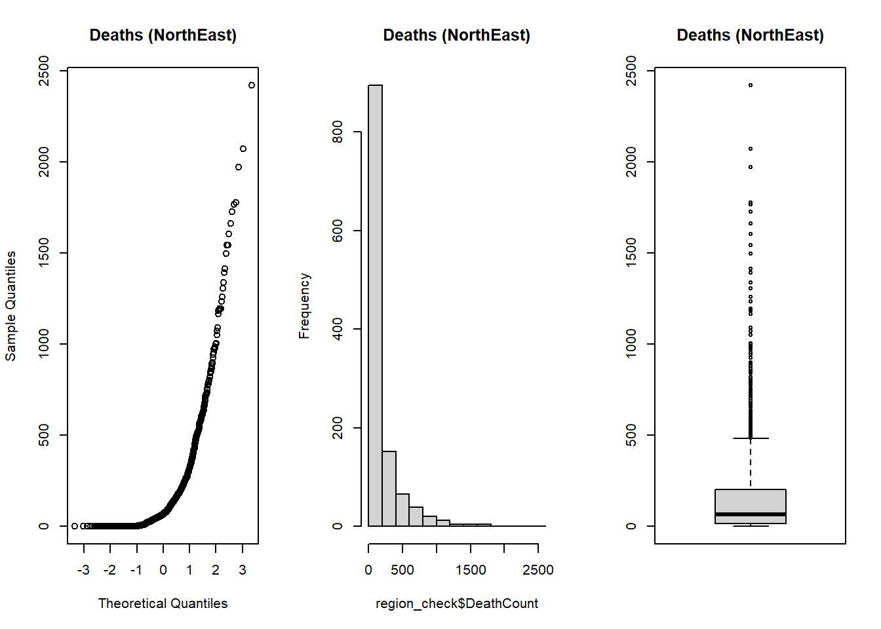
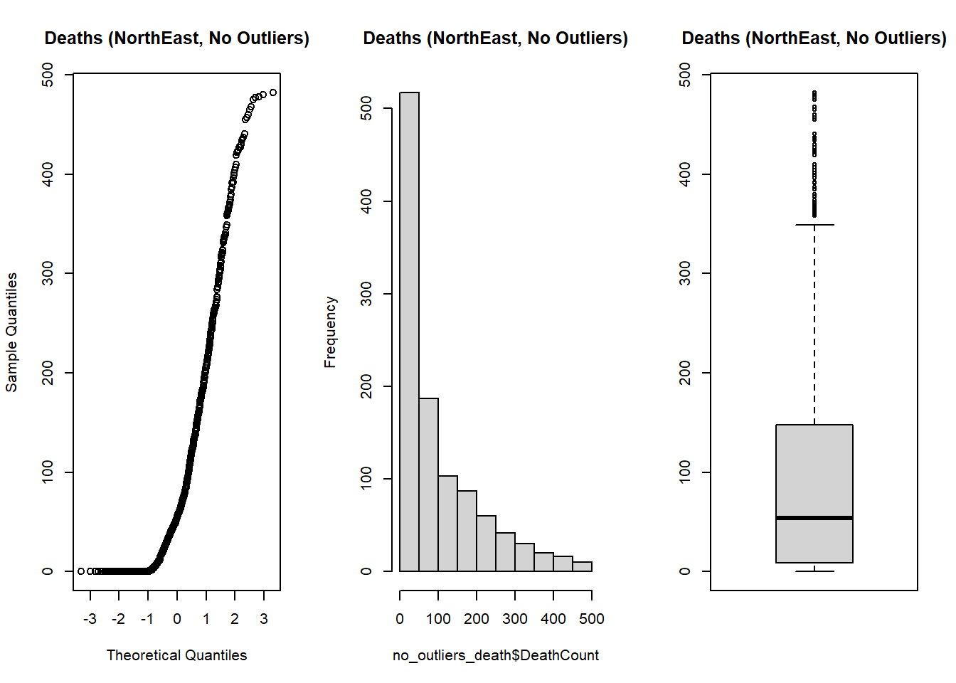
With Outliers
Without Outliers
MidWest
94 Outliers Removed
NorthEast
129 Outliers Removed
Notes:
MidWest -1257
MidWest Outliers Removed -1163 (94 removed)
NorthEast - 1200
NorthEast Outliers Removed – 1071 (129 Total)

Slide 9
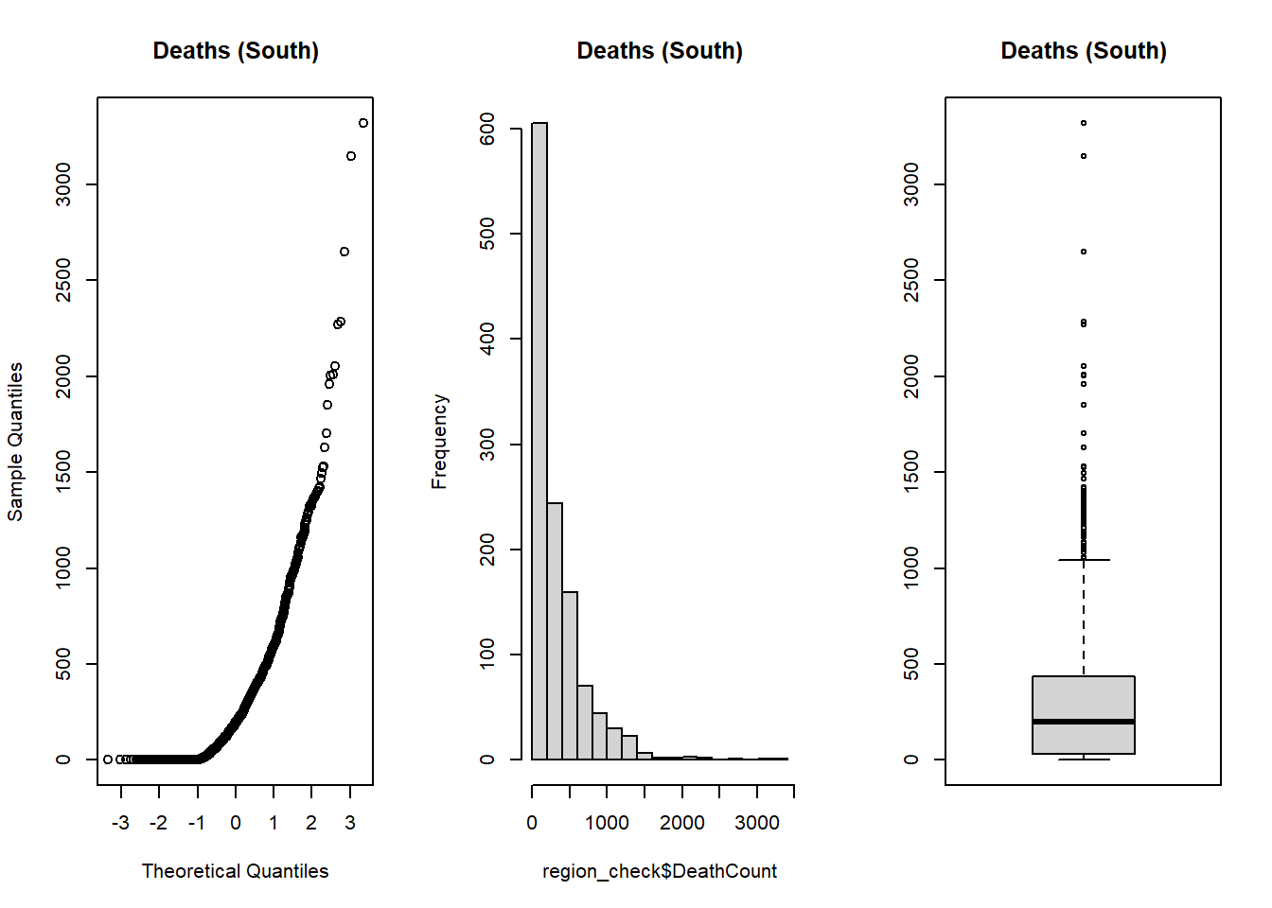
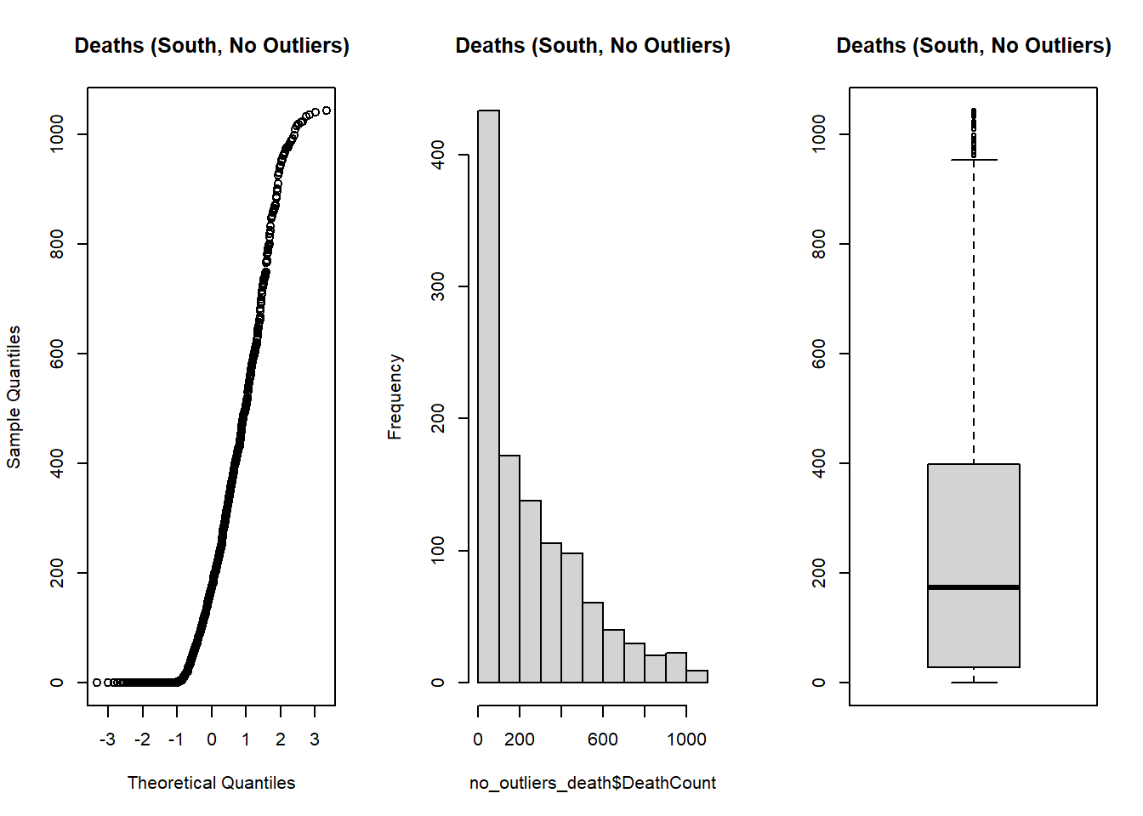
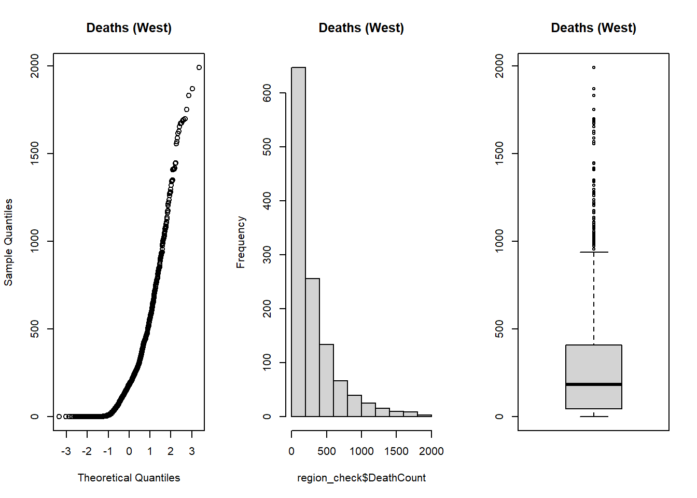
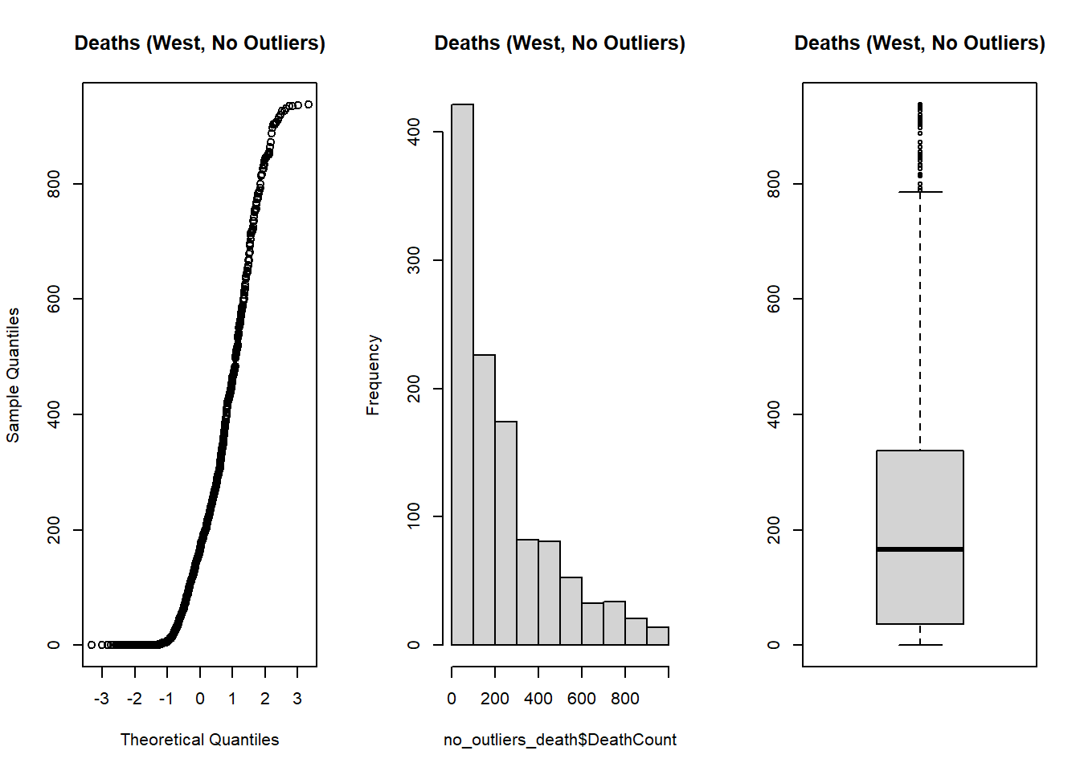
With Outliers
Without Outliers
South
70 Outliers Removed
West
77 Outliers Removed
Notes:
MidWest -1257
MidWest Outliers Removed -1163 (94 removed)
NorthEast - 1200
NorthEast Outliers Removed – 1071 (129 Total)

Slide 10
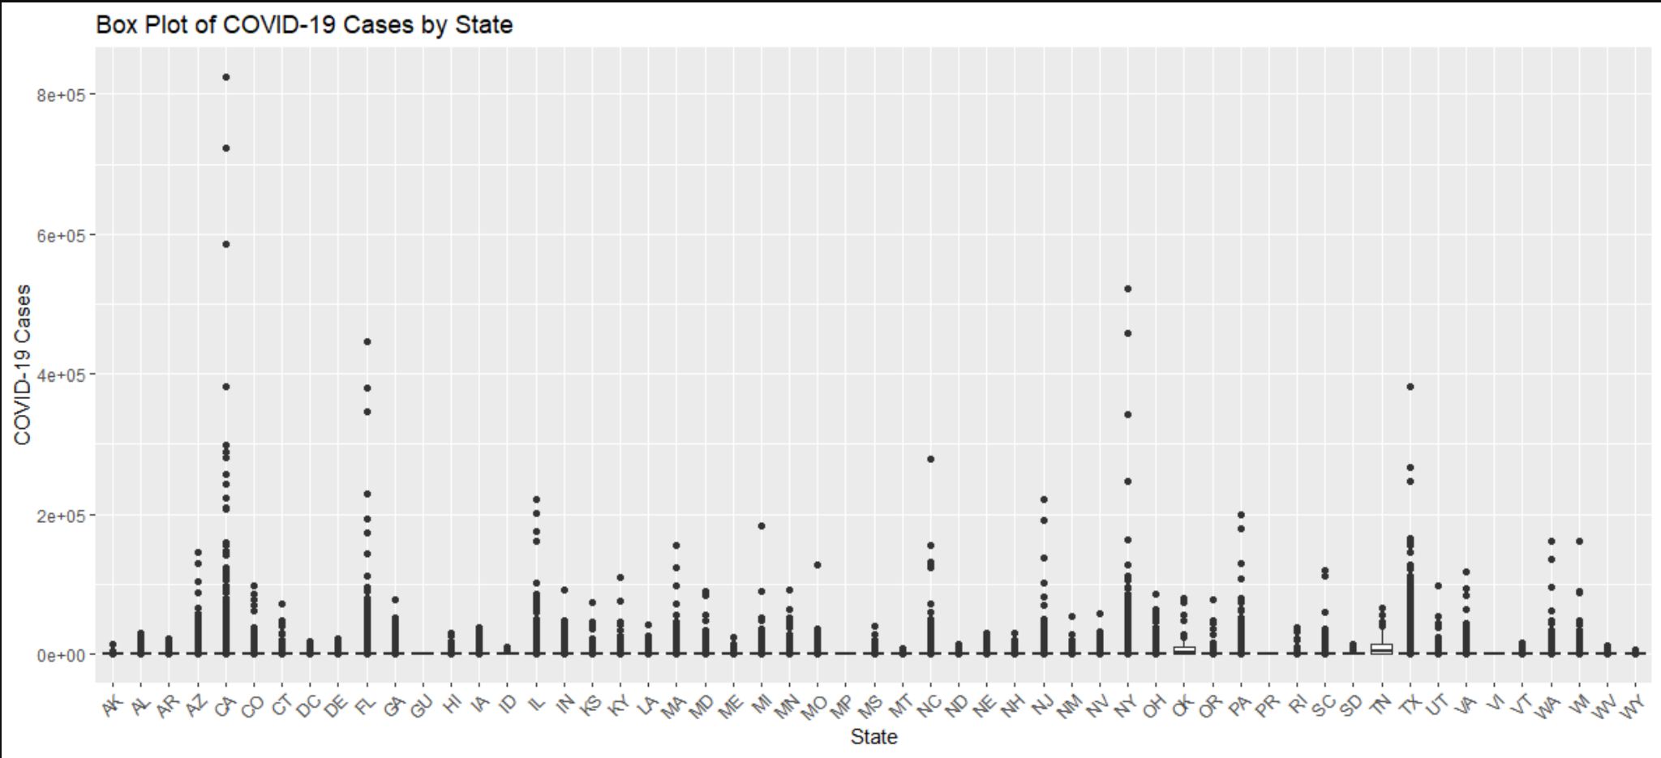
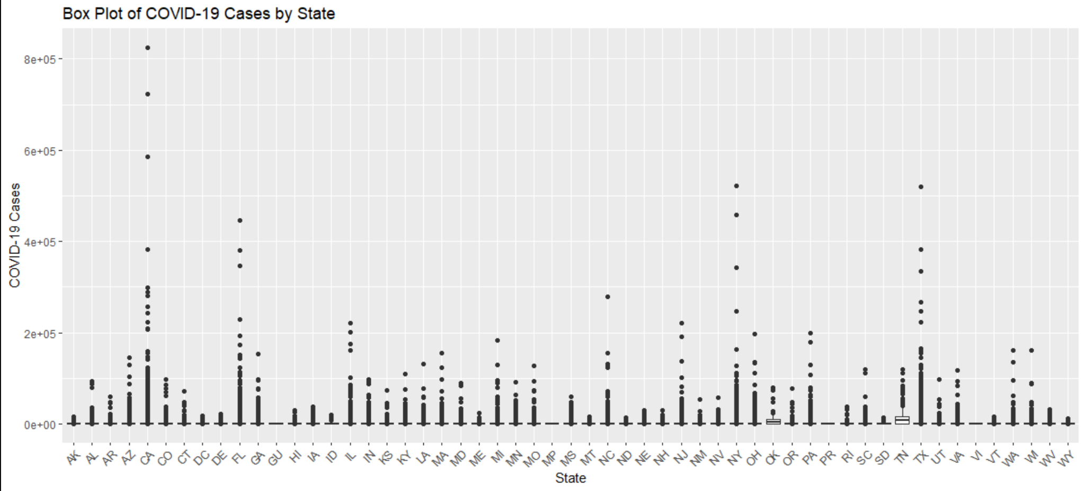
With Outliers
Without Outliers
MidWest
94 Outliers Removed
NorthEast
129 Outliers Removed
Notes:
MidWest -1257
MidWest Outliers Removed -1163 (94 removed)
NorthEast - 1200
NorthEast Outliers Removed – 1071 (129 Total)

Slide 11
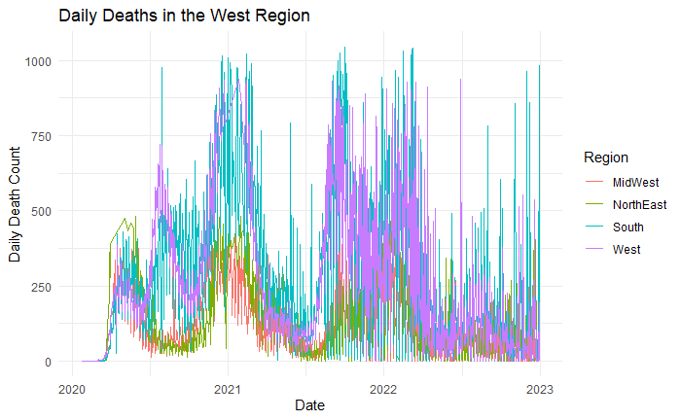
Daily Deaths by Region

Slide 12
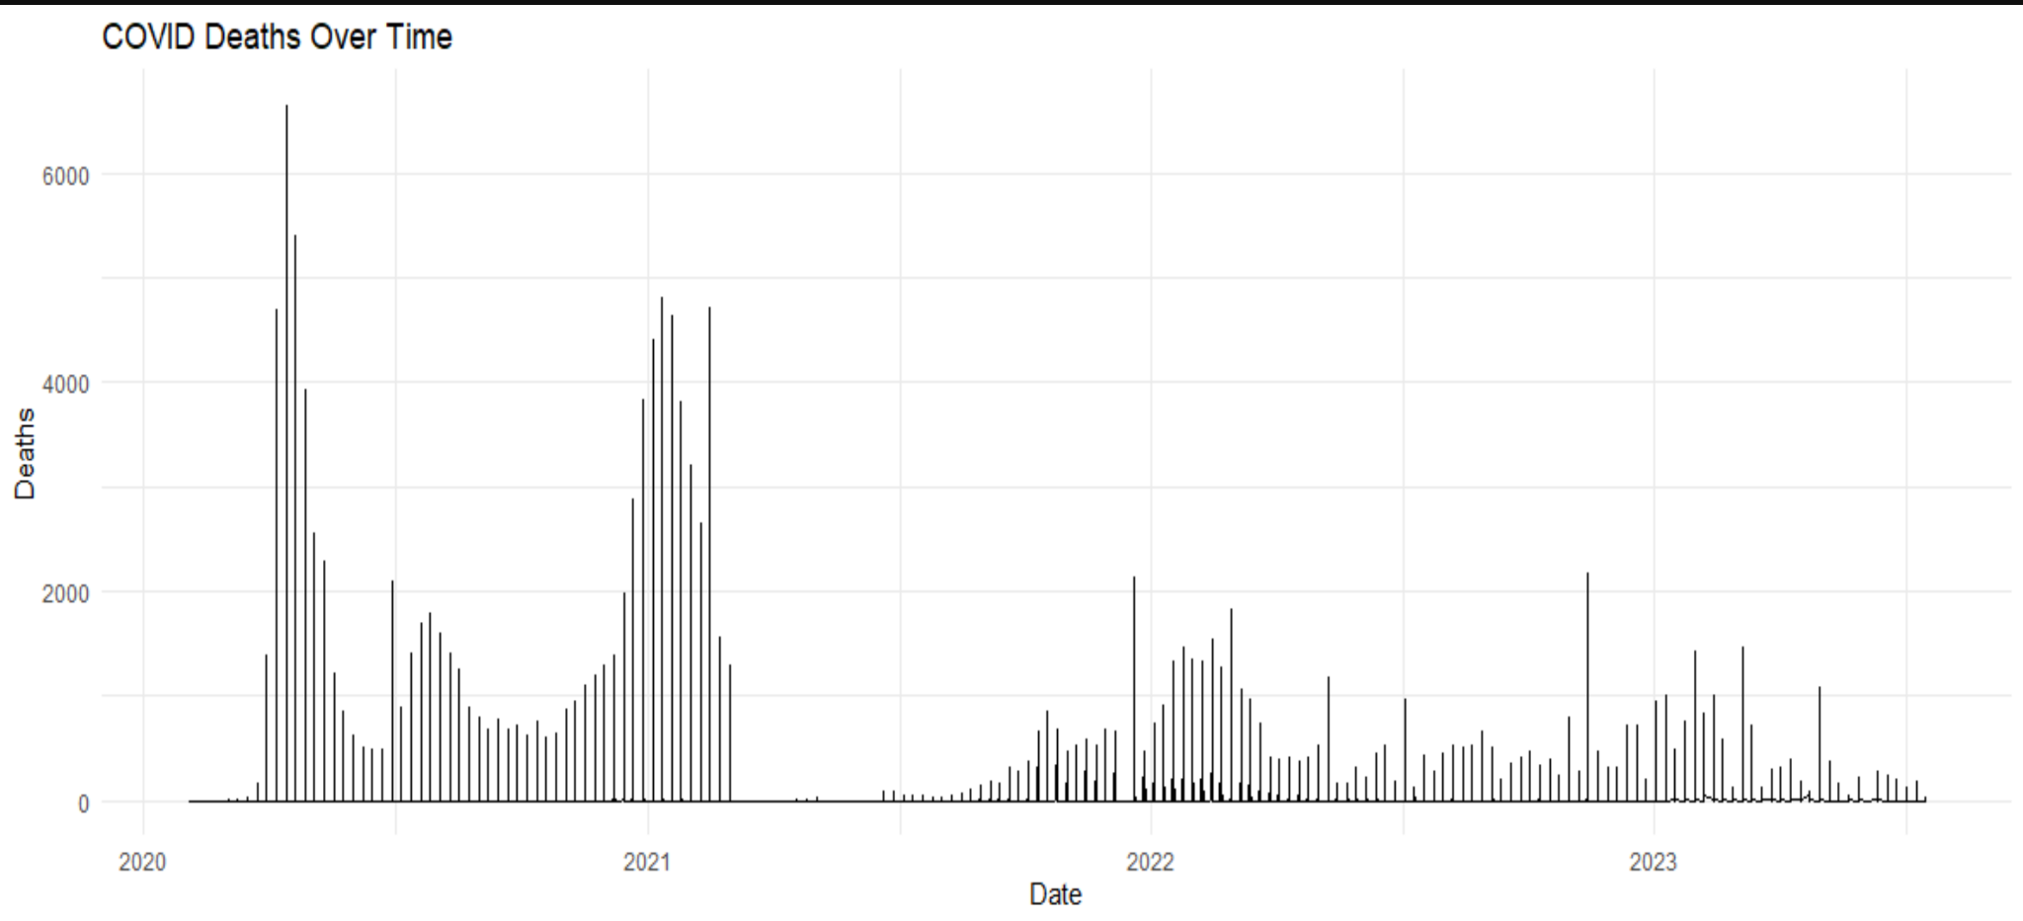
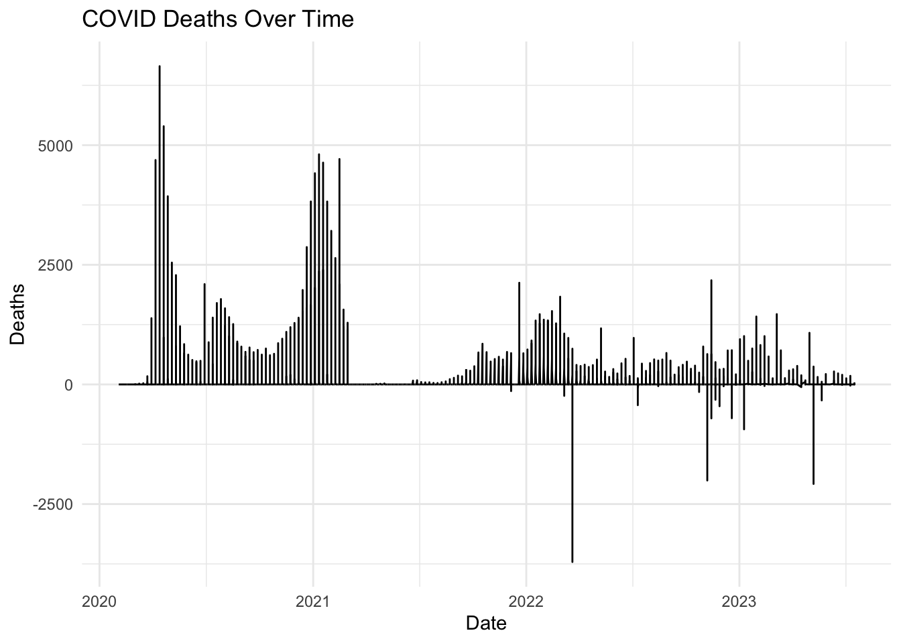
Weekly Deaths Across States

Slide 13
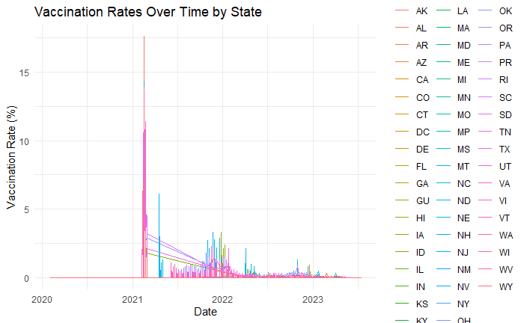
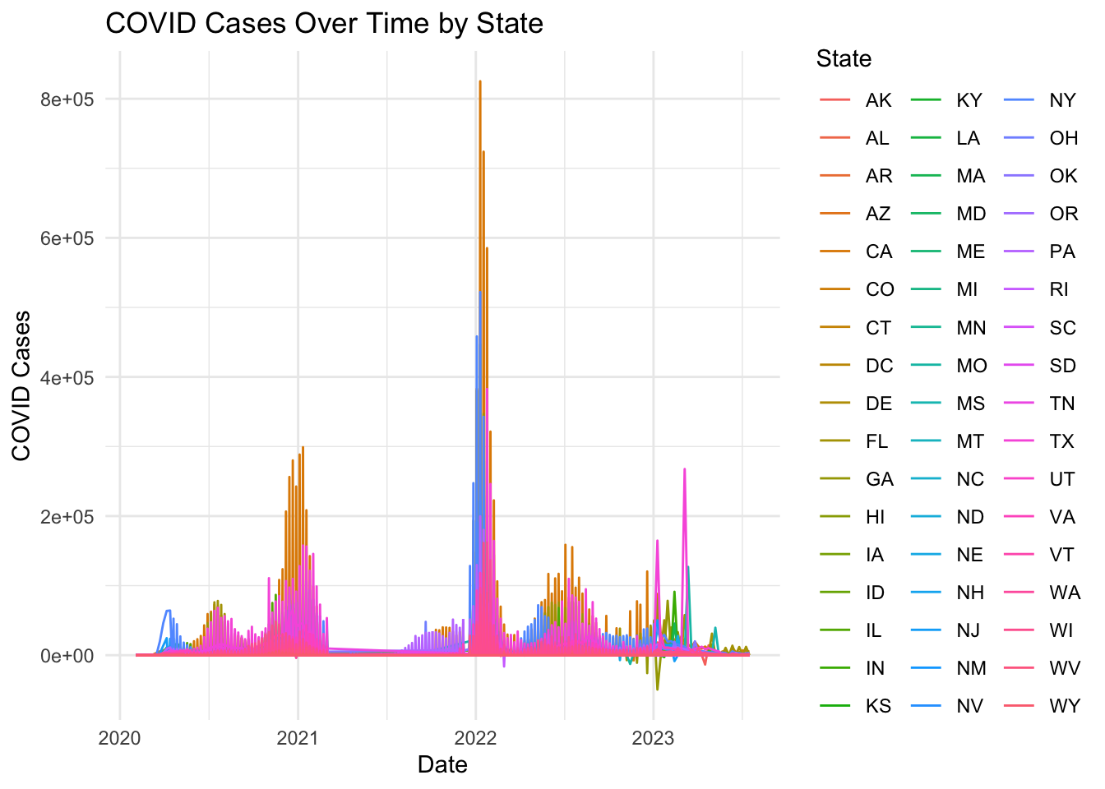

Slide 14
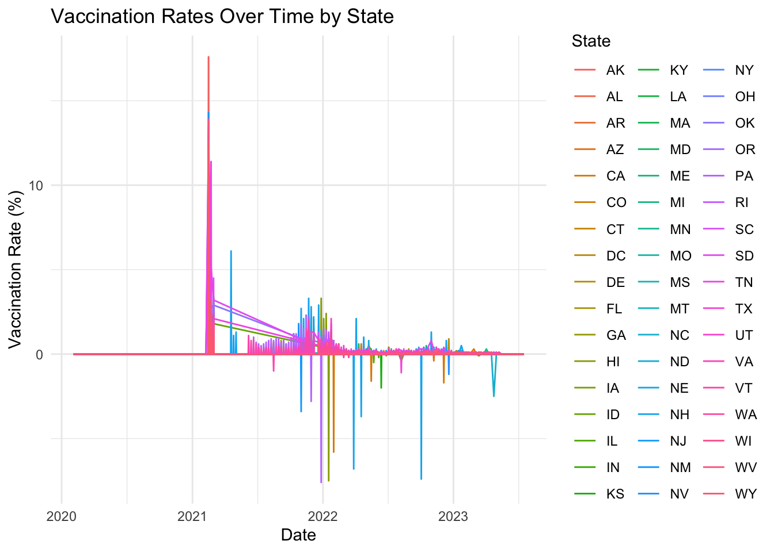

Slide 15
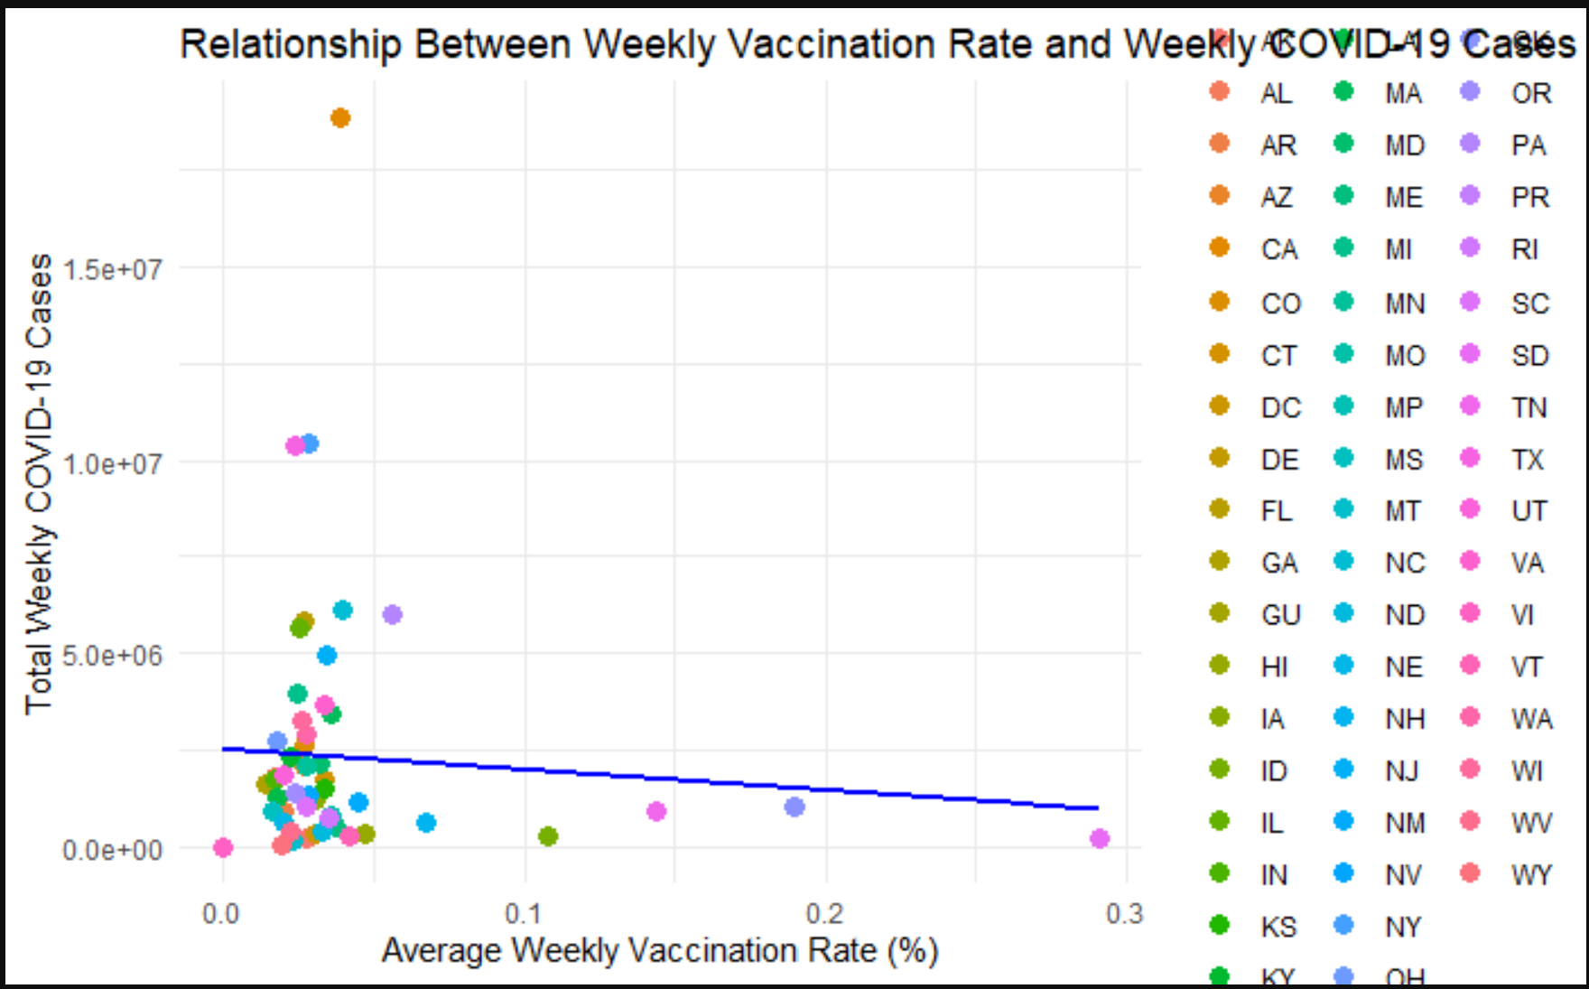

Slide 16
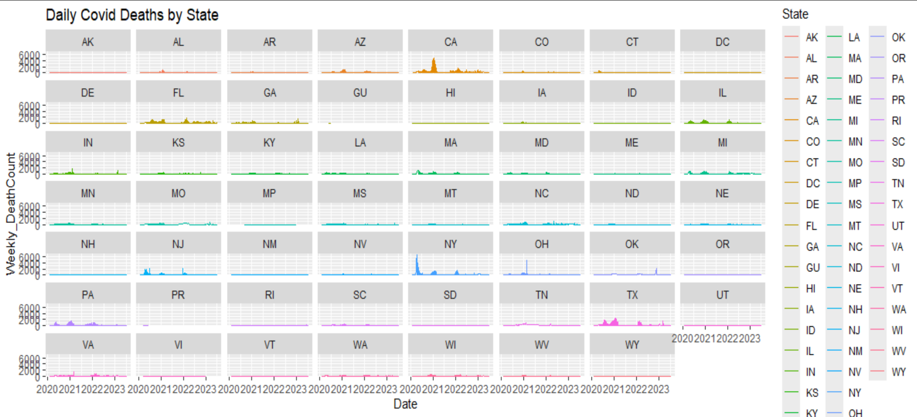
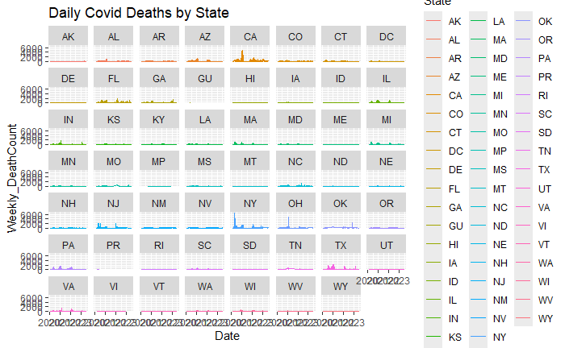

Slide 17
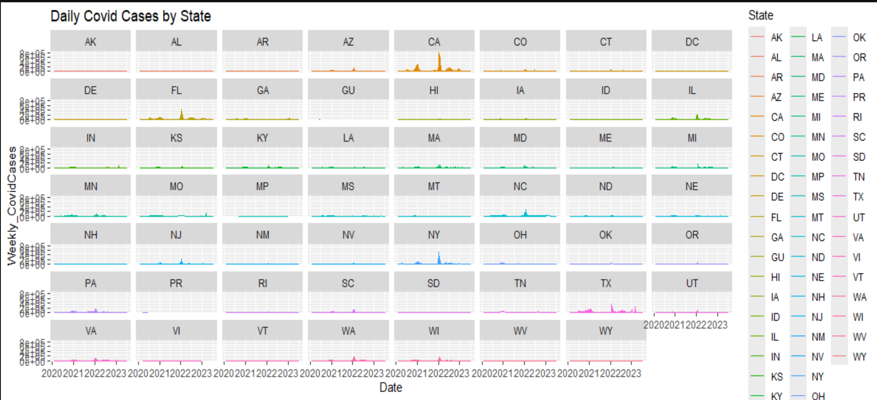
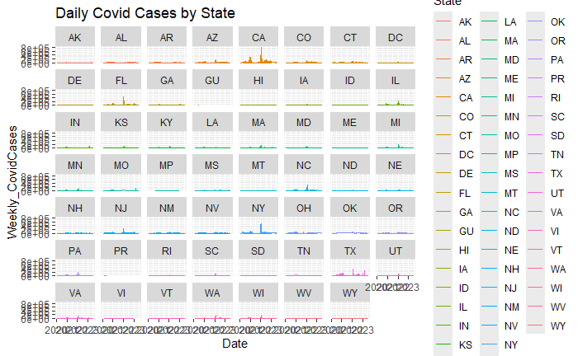

Slide 18
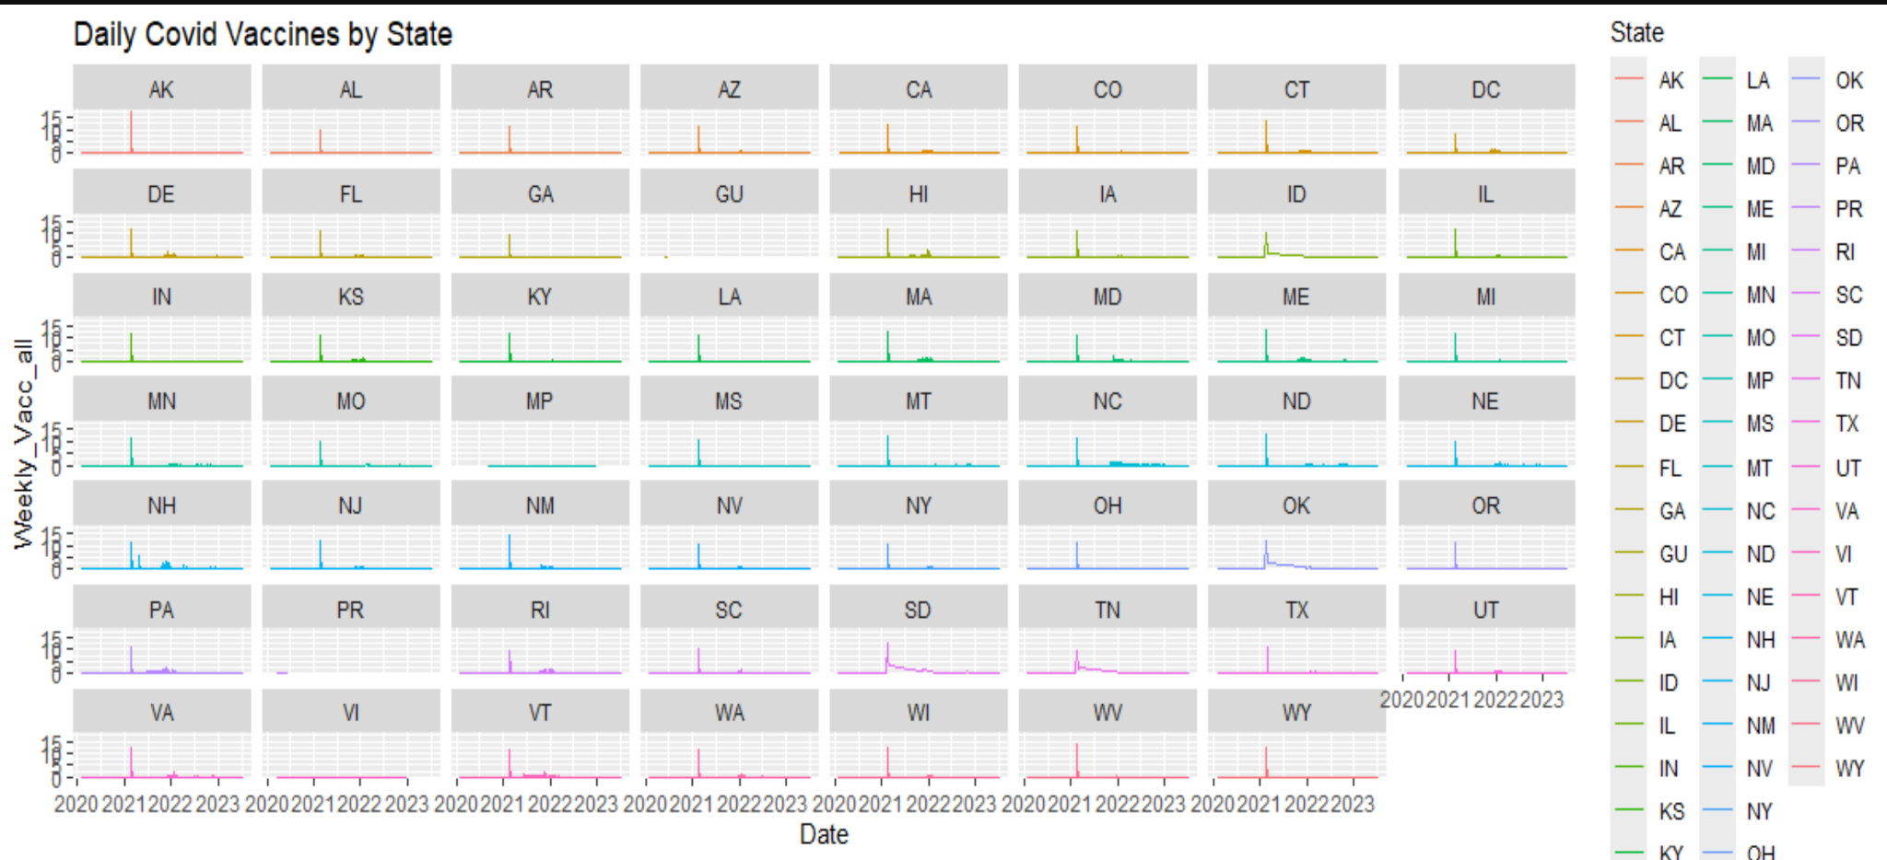
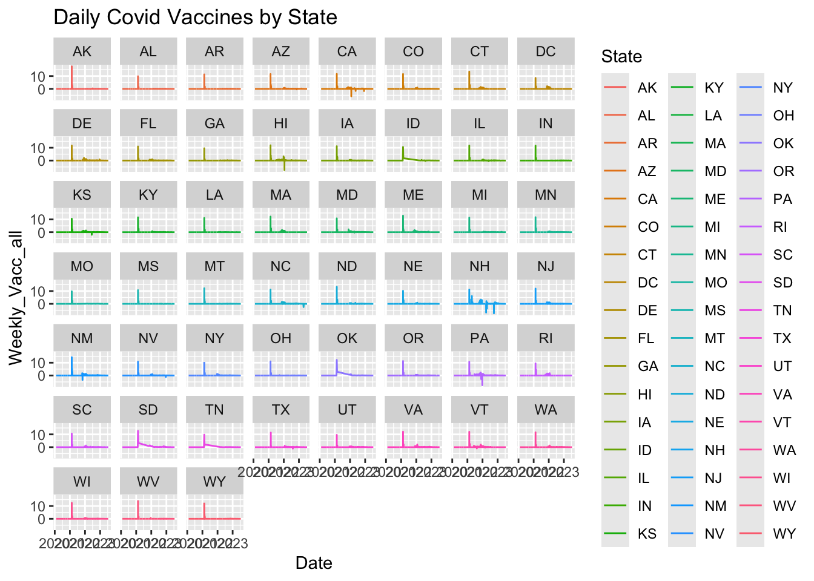
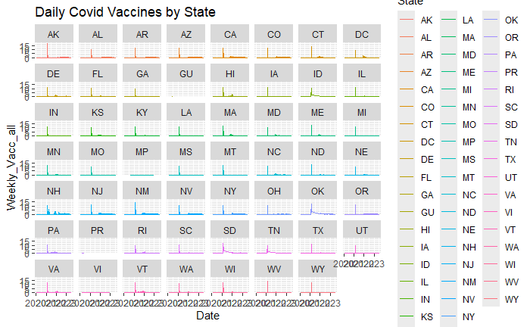

Slide 19
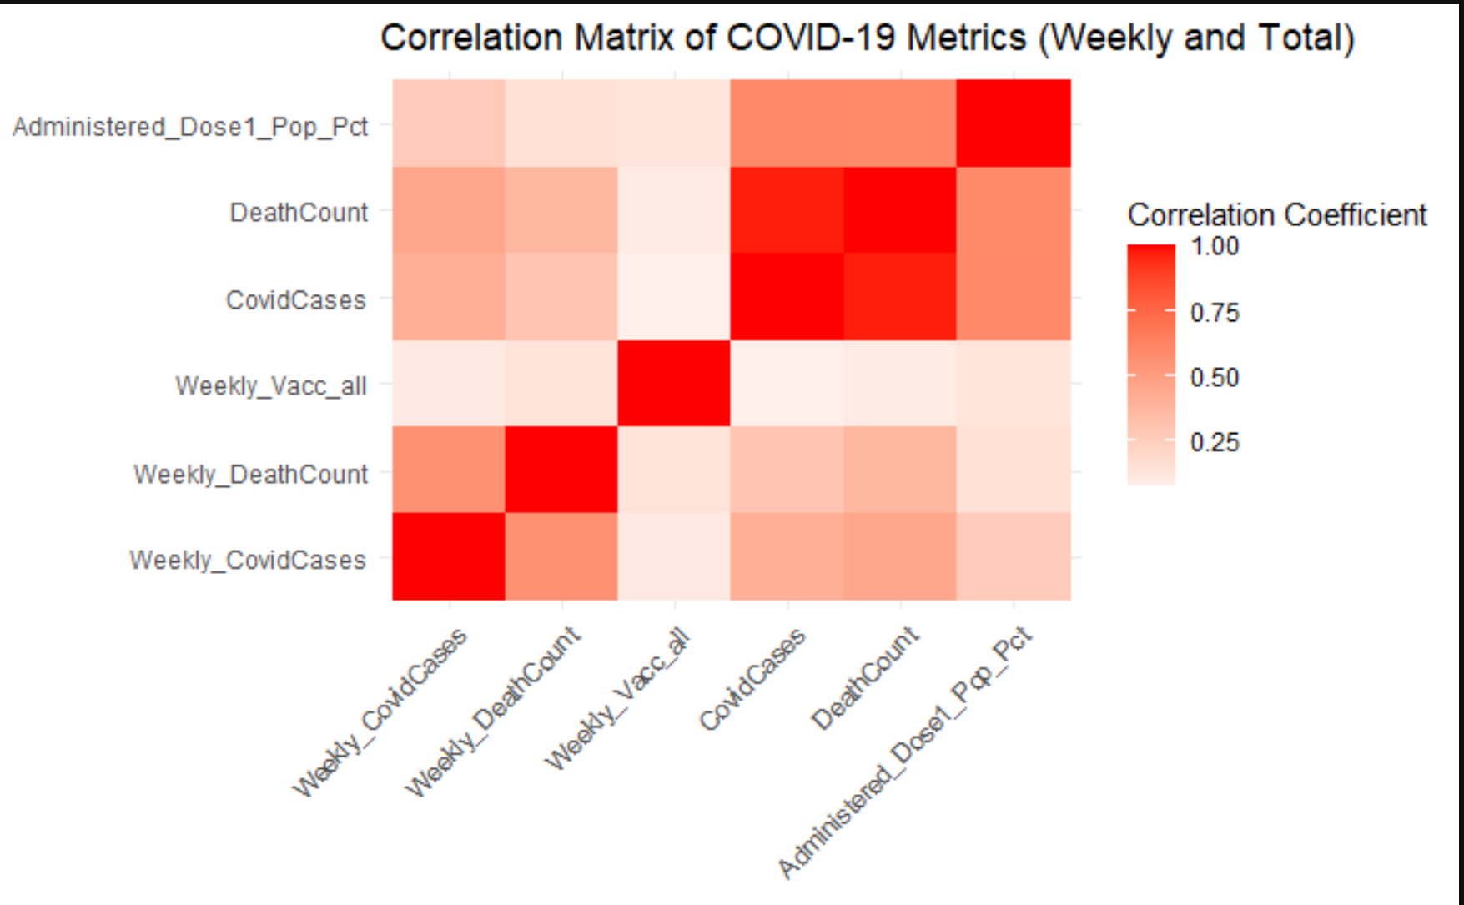

Slide 20
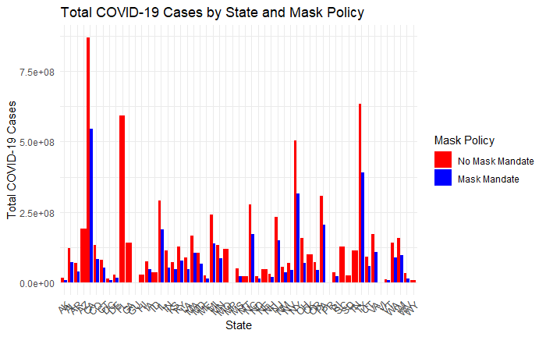

Slide 21
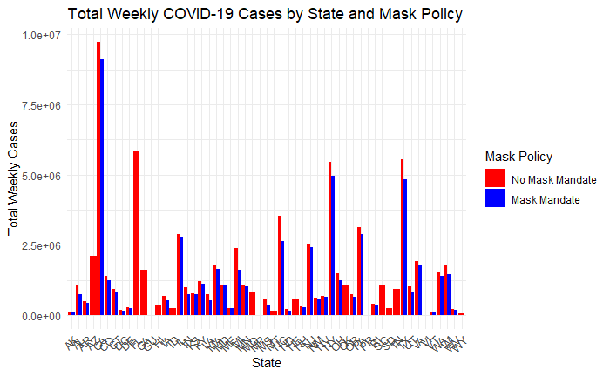
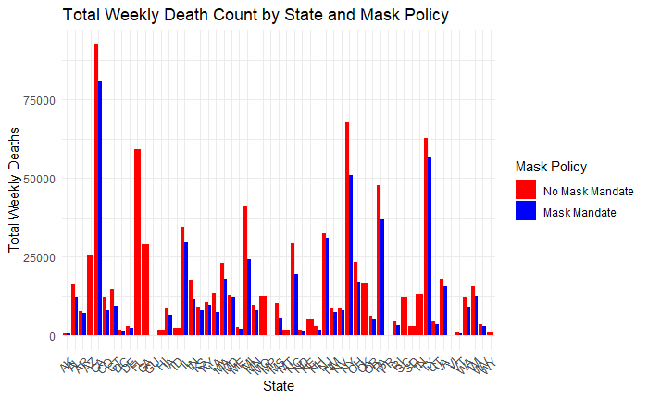
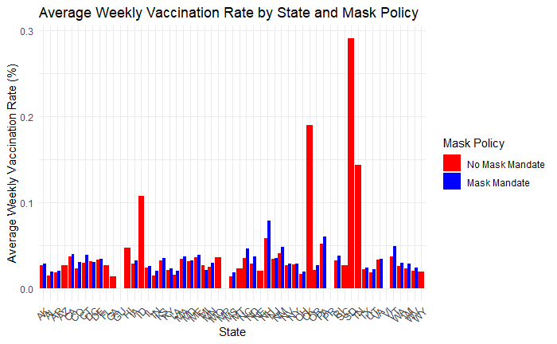
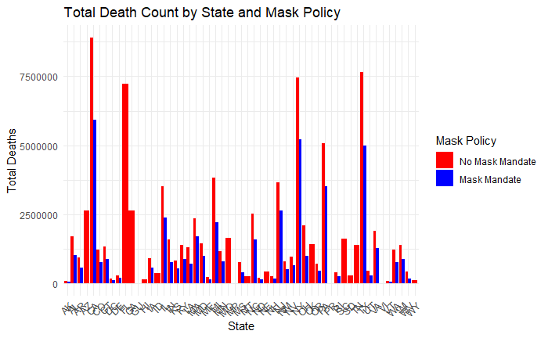

Slide 22
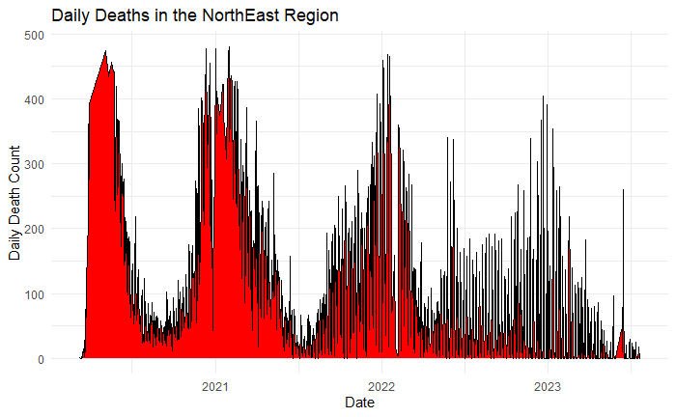
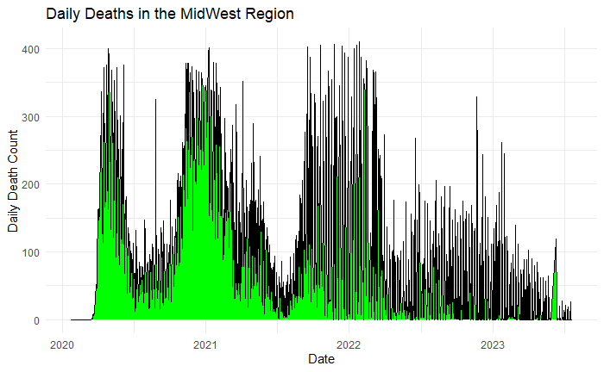
Daily Deaths by Region

Slide 23
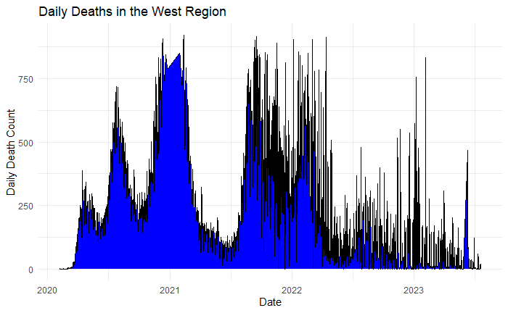
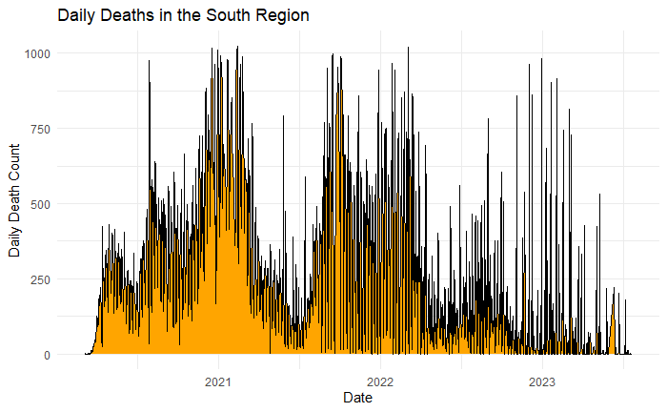
EDA Deaths (West, South)

Slide 24

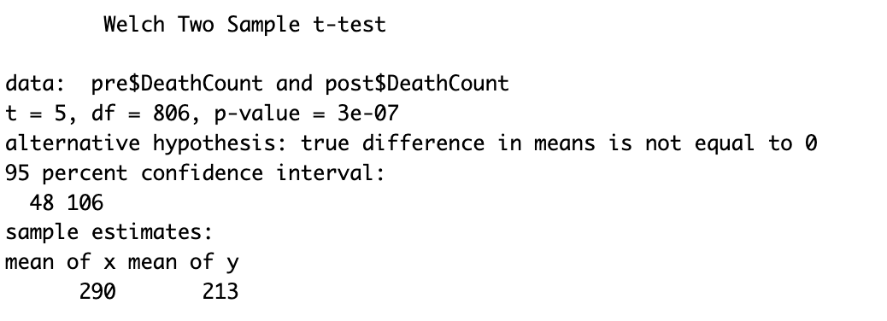
Hypothesis Testing
Did reaching a 30% vaccination rate impact deaths?
H0: Vaccinees did not impact deaths.
Ha: Vaccinees impacted deaths

Slide 25
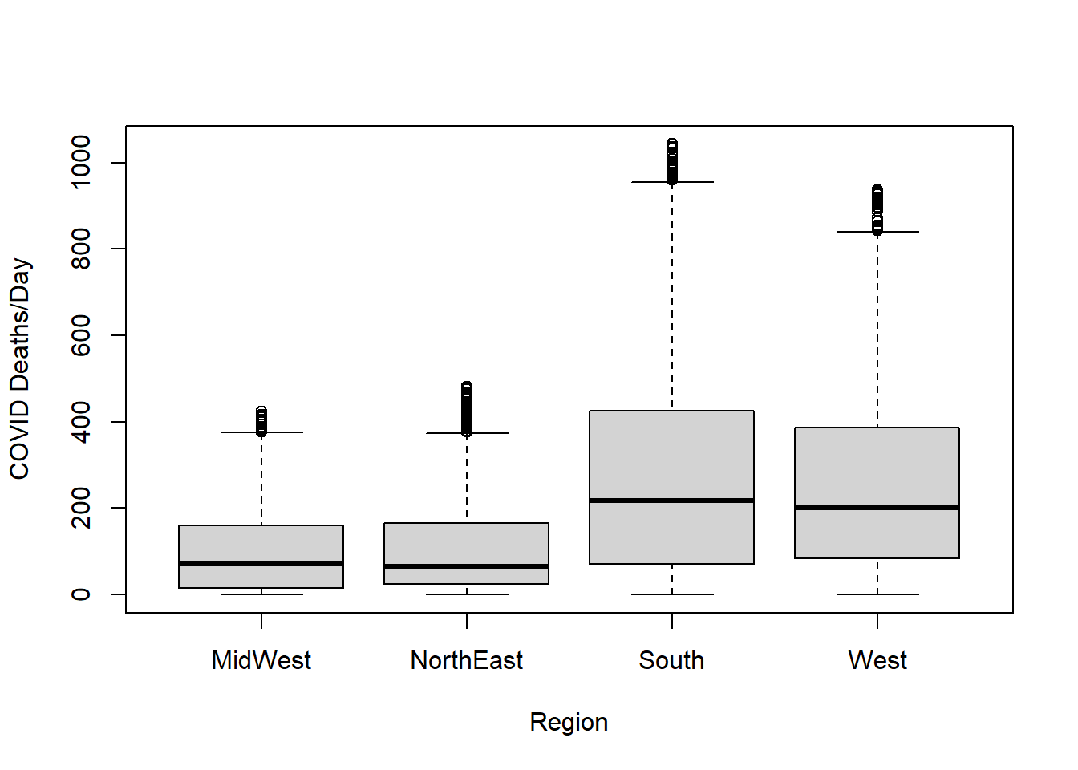
One Way ANOVA
 | Df | Sum Sq | Mean sq | F value | Pr(>F)
Region | 3 | 2.56e+07 | 8547638 | 237 | 0
Residuals | 3780 | 1.36e+08 | 35991

Slide 26
Regional T-tests
Re-ran T-tests by region
Each region showed significant difference before and after 11/3
 | Low CI | High CI | df | P-value
MidWest | 34.6 | 62.5 | 727 | 2e-11
NorthEast | 6.86 | 36.17 | 801 | 0.004
South | 52.1 | 117.9 | 750 | 5e-07
West | 48 | 106 | 806 | 3e-07

Slide 27
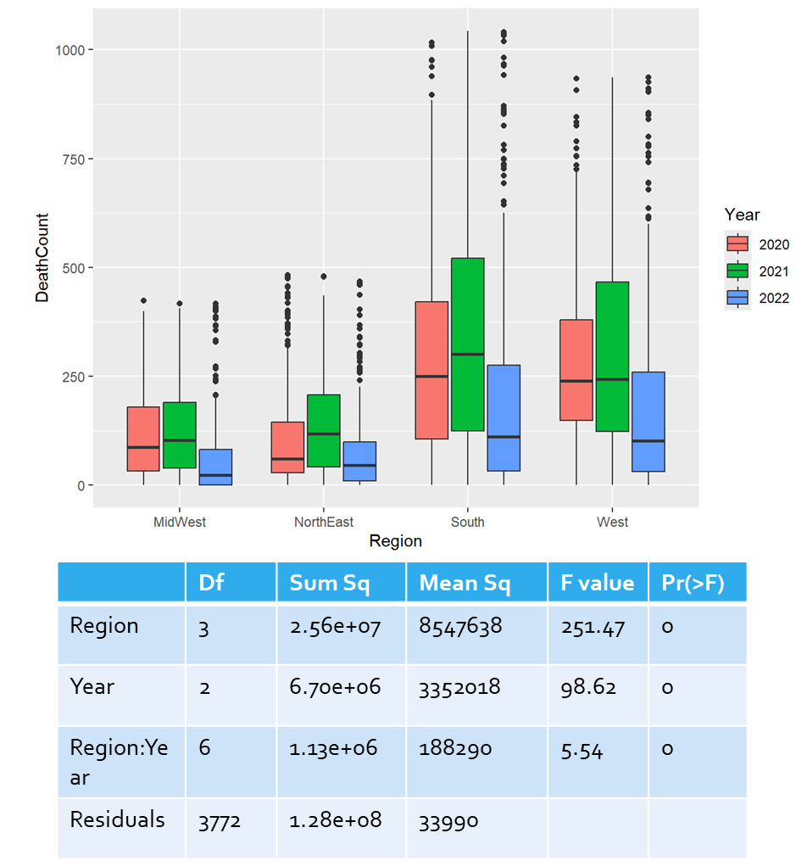
Two Way ANOVA

Slide 28
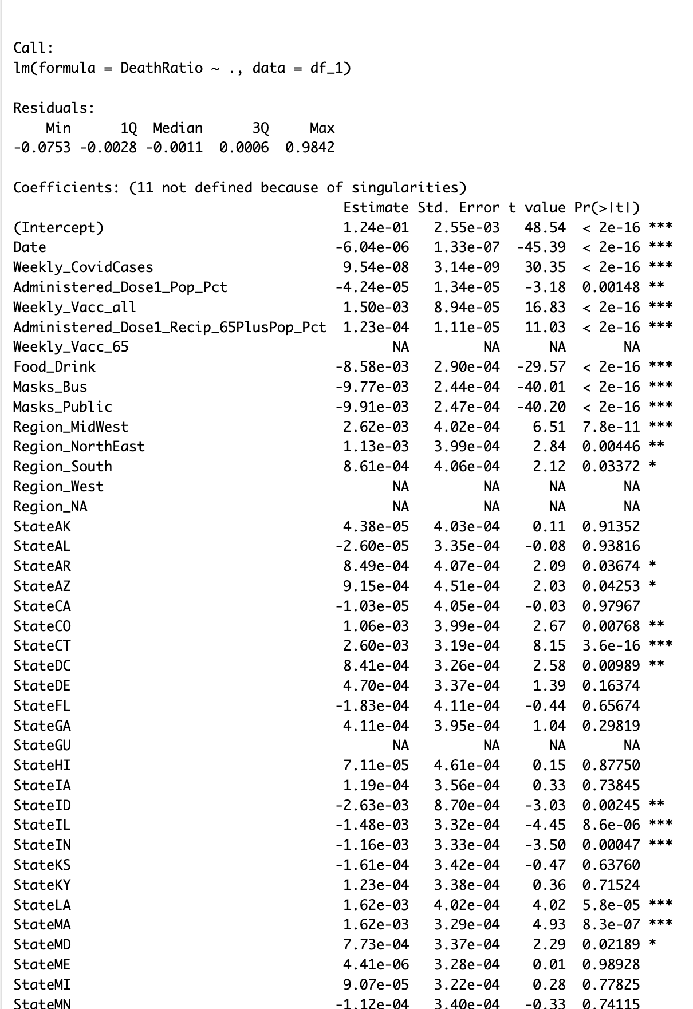
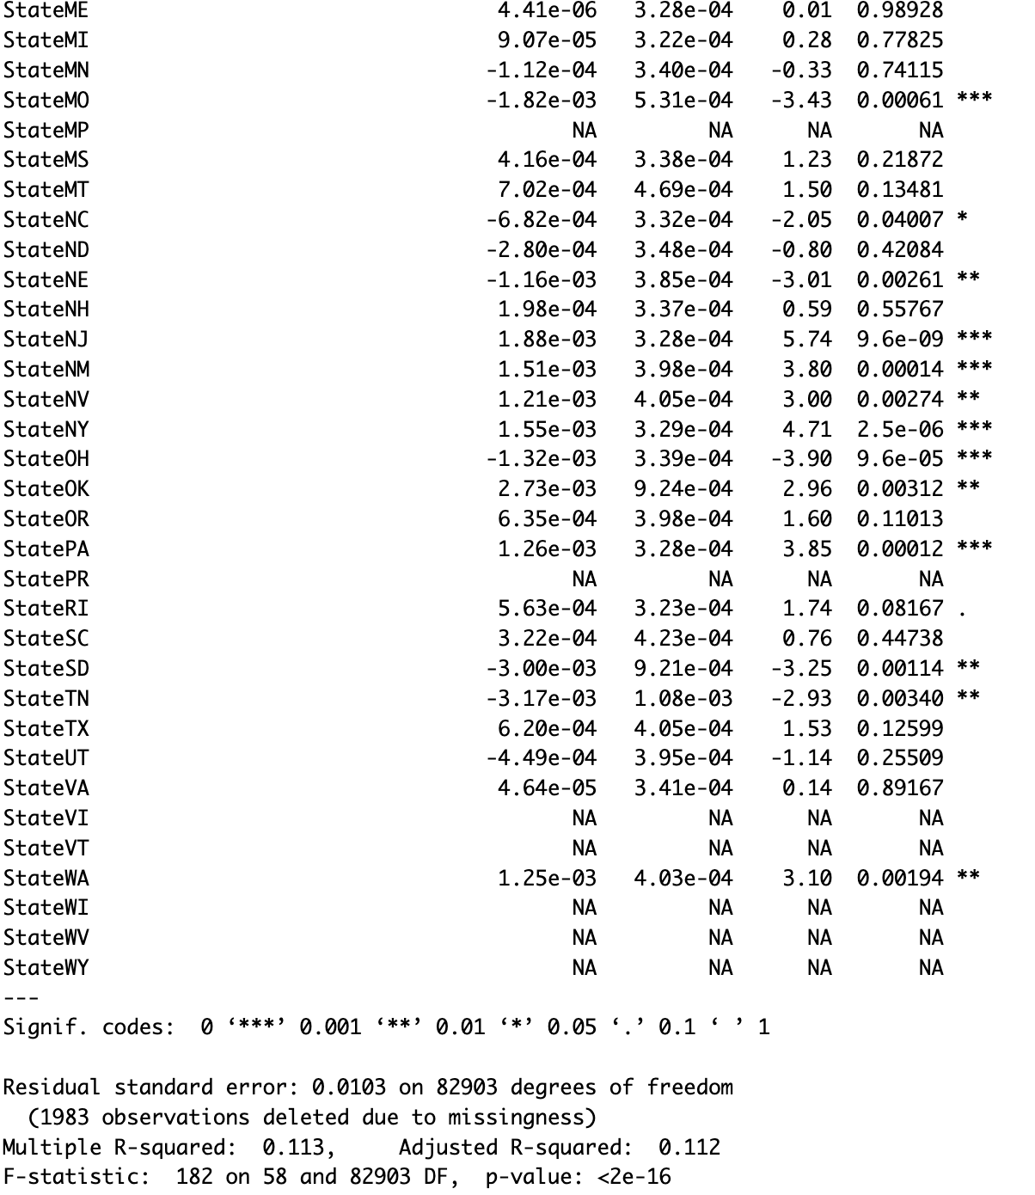
Region vs State
Inefficient
Multilinearlity
Low variance

Slide 29
Feature Selection
 | Estimate | Std. Error | t value | Pr(>|t|)
(Intercept) | 0.016352 | 0.001135 | 14.41 | < 2e-16 | ***
Weekly_Vacc_all | 0.112665 | 0.025335 | 4.45 | 8.80E-06 | ***
Food_Drink | -0.00227 | 0.001538 | -1.47 | 0.1405
Masks_Bus | -0.0085 | 0.001186 | -7.17 | 8.40E-13 | ***
Masks_Public | -0.00976 | 0.001218 | -8.01 | 1.30E-15 | ***
Region_MidWest | 0.002725 | 0.001022 | 2.67 | 0.0077 | **
Region_NorthEast | 0.004442 | 0.000805 | 5.52 | 3.50E-08 | ***
Region_South | 0.000179 | 0.000703 | 0.25 | 0.7992
year_2020 | 0.0144 | 0.001539 | 9.36 | < 2e-16 | ***
year_2021 | 0.007666 | 0.001761 | 4.35 | 1.40E-05 | ***
year_2022 | 0.004247 | 0.001604 | 2.65 | 0.0081 | **
Linear Model
Full model: Death/Case = intercept + b1(Vacc rate) + b2(policy) + b3(region) + b4(year)
Reference: no policy, 2023, West Region
Adjusted R-squared: 0.0492
AIC -38455

Slide 30
Stepwise (both direction) feature selection
 | Estimate | Std. | Error | t-value | Pr(>|t|)
(Intercept) | 0.016437 | 0.001085 | 15.15 | 2.00E-16 | ***
Weekly_Vacc_all | 0.112664 | 0.025334 | 4.45 | 8.80E-06 | ***
Food_Drink | -0.00226 | 0.001538 | -1.47 | 0.1415
Masks_Bus | -0.00851 | 0.001186 | -7.17 | 7.90E-13 | ***
Masks_Public | -0.00976 | 0.001218 | -8.02 | 1.20E-15 | ***
Region_MidWest | 0.002631 | 0.000952 | 2.76 | 0.0058 | **
Region_NorthEast | 0.004348 | 0.000716 | 6.08 | 1.30E-09 | ***
year_2020 | 0.014416 | 0.001538 | 9.37 | 2.00E-16 | ***
year_2021 | 0.007684 | 0.00176 | 4.37 | 1.30E-05 | ***
year_2022 | 0.004262 | 0.001603 | 2.66 | 0.0079 | **
Linear Model
Removed South Region for minimal improvement in adj. R^2 and AIC
Adjusted R-squared: 0.0493
AIC -38457

Slide 31
Conclusions
Did vaccinations impact survival rates from COVID-19 between 2020 and 2023?
A: No, vaccination rates were positively correlated with death rates.
Were there differences in COVID-19 survival rates between regions of the US?
A: Yes, death rates were positively correlated with the midwest and northeast regions
Did policy choices made by states impact survival rates?
A: Yes, mask mandates (business and public) were positively correlated with survival rate.

Slide 32
Implications
Why were vaccinations positively correlated with death rates?
Likely a missing variable problem. Adj. R^2 was small meaning we didn’t capture much of the variance.
Why did we exclude state dummies?
There was strong multicollinearity and low variance in some states after removing outlines.
State reporting policies resulted in bad data for some states
Why not use Beta regression?
Similar results
Errors in R without good documentation

Slide 33

Questions

